Slide 1
Fly Weight Pattern
By
Narendran, S S

Slide 2
Key Items
Collection Pattern
Intrinsic Information (State Independent) & Extrinsic Information (State Dependent)
Need for High No. of Objects Creation
Sharing Objects
A variation of Singleton
optimization pattern

Slide 3

Fly Weight Pattern
“Use sharing to support large numbers of fine-grained objects efficiently”. Sharing is key in flyweight pattern and we need to judiciously decide if this pattern can be applied.
A flyweight is an object that minimizes memory use by sharing as much data as possible with other similar objects; it is a way to use objects in large numbers when a simple repeated representation would use an unacceptable amount of memory. Often some parts of the object state can be shared, and it is common practice to hold them in external data structures and pass them to the flyweight objects temporarily when they are used.
Notes:
Front Controller is a good Example, but all Controllers are not façade.

Slide 4
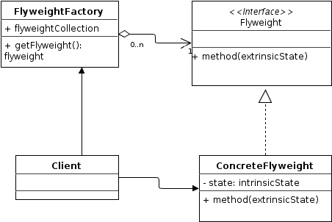
Fly Weight Pattern - UML

Slide 5
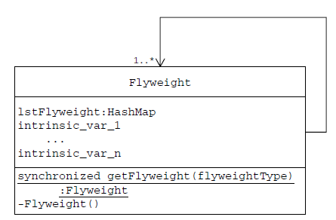
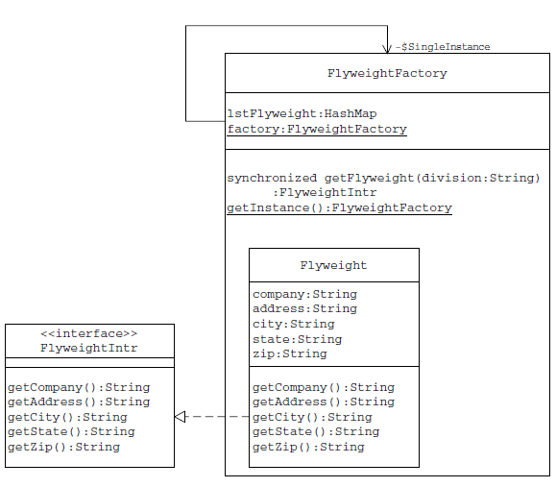
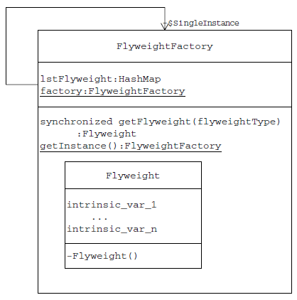
Fly Weight with Inner Classes

Slide 6
Pros and Cons
Pros
Flyweight explains when and how State objects can be shared.
Flyweight is often combined with Composite to implement shared leaf nodes.
Whereas Flyweight shows how to make lots of little objects, Facade shows how to make a single object represent an entire subsystem.
Cons
This is only an optimization pattern. It does nothing other than improve the efficiency of your code under a strict set of conditions. It can’t, and shouldn’t, be used everywhere; it can actually make your code less efficient if used unnecessarily. In order to optimize your code, this pattern adds complexity, which makes it harder to debug and maintain.
Instead of having a clean architecture of objects encapsulating data, you now have a fragmented mess with data being stored in at least two places.
Trade-offs must always be made between run-time efficiency and
maintainability, but such trade-offs are the essence of engineering

Slide 7
References
http://javapapers.com/design-patterns/flyweight-design-pattern/
http://sourcemaking.com/design_patterns/flyweight
Software Architecture Design Patterns in Java by Partha Kuchana
http://yuiblog.com/assets/projsdesignpatterns-ch9.pdf

